Slide 1
Weighted Set Cover
By: Ali Mowazi, Mark Kasun, Jeremiah O’Neil

Slide 2
Introduction to Weighted Set Cover
Weighted Set Cover in decision form is NP- Complete.
Given a Set E = {e_{1,} e_{2,} … ,e_{n}} of n elements, a collection of m subsets S₁, S₂, … ,S_{m} of E with weights w₁,w₂,…,w_{m}. Goal to find a set I ⊆ {S_{i},...,S_{m}} such that all elements covered by I and the sum of the weights in I is minimized.
In Decision form: Can we find a set cover with weight at most W.
The study of weighted set cover led to development of fundamental techniques for the entire field of approximation algorithms.

Slide 3
Example
Assume weight of each subset is 1
Find the minimal set cover.
In decision form it is: Does there exist a set cover of weight W?

Slide 4
Our Strategies for Solving Set Cover
Greedy Approximation Algorithm
Greedy Heuristic
Simulating Annealing (In Progress)

Slide 5
Greedy Approximation Algorithm
The algorithm runs in O(n*log(n)) time and is quite simple to implement
Let C be a set of elements covered, U be the set of all elements, and X to be a list of sub-sets picked
Initialize C={}, X=[]
While |C| =/= |U|
Find sub-set S with smallest cost effectiveness (cost of S divided by uncovered elements)
Set C=C ∪ S
Output X

Slide 6
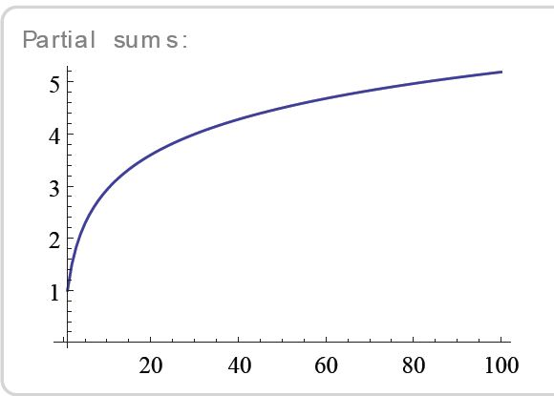

Greedy Approximation Guarantee
Greedy algorithm guarantees cost <= H_{k}*OPT
k is the size of the largest subset
At k=4, α>2
At k=11, α>3

Slide 7
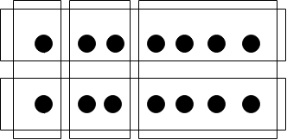
Greedy Approximation Example
OPT = 2, Greedy solution = 3
H₈*OPT = 5.4 (total sets = 5)

Slide 8
Greedy Heuristic
Intended to quickly find an initial feasible solution and to construct neighbouring solutions for Simulated Annealing in a randomized manner. We use a fast heuristic proposed by Balas and Ho in 1987.
Initialize C={} and X=[]
While |C| =/= |U|
Pick a random element in C, and find the set S of minimal cost which covers the element
Set C=C ∪ S and append S to X
Examine each selected set, in order by recency of selection. If the set is redundant – it can be removed without leaving an element uncovered -- remove it.
Return the cover X.

Slide 9
Running Times

Slide 10
Running Time normalized

Slide 11
Results against SCP data set (%Optimal)

Slide 12
Edges Required to hit every 4-cycle in a hypercube

Slide 13
4-tuples forming the smallest non-bi-chromatic hypergraph

Slide 14
Simulated annealing
GENERATE an initial solution X
for T in schedule:
SEARCH for a neighbour solution X'
let deltaE = W(X) - W(X')
if deltaE < 0 or rand(0, 1] < exp(-deltaE/T)
let X = X'
return X

Slide 15
GENERATE and SEARCH subprocedures.
These subprocedures respectively define the initial state and neighbourhood of states. We base both on the fast heuristic.
The GENERATE subprocedure just runs the heuristic from C={} and X=[].
The SEARCH subprocedure randomly removes sets from a feasible cover X, creating a partial cover which is then completed by the heuristic.

Slide 16
Other Methods for Solving Set Cover
Linear Programming
Ant Colony Optimization
Beasely and Chu Genetic Algorithm
Haddadi Langrangian Heuristic
Aickelin Indirect Genetic Algorithm

Slide 17
Applications of Set Cover
IBM finds computer viruses
5000 known viruses (elements)
9000 substrings of 20 or more consecutive bytes from viruses (Number of Sub Sets)
Set Cover of 180 substrings found, meaning only search for 180 substrings instead of 9000.
Speech recognition software (choose certain set of words)
Resource allocation
Assembly line balancing
Vehicle routing

Slide 18
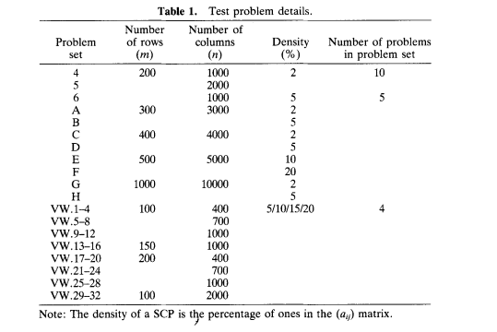
SCP Data set information

Slide 19
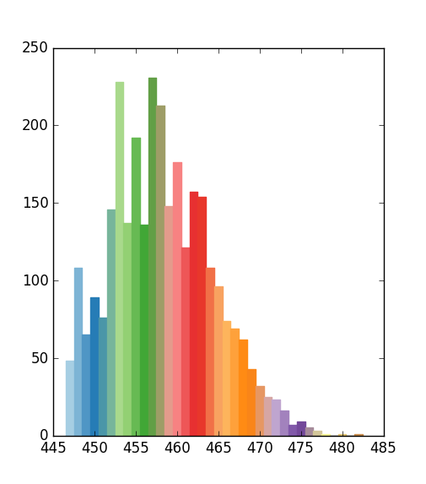
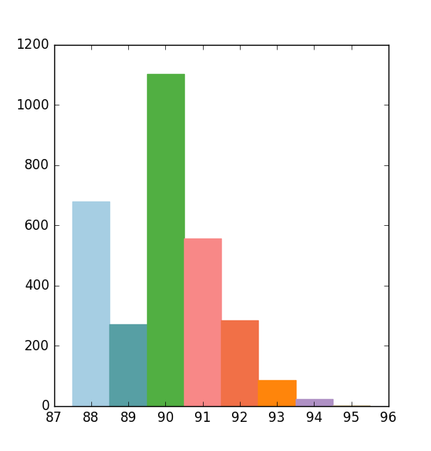
SCP47, SCPB2

Slide 20
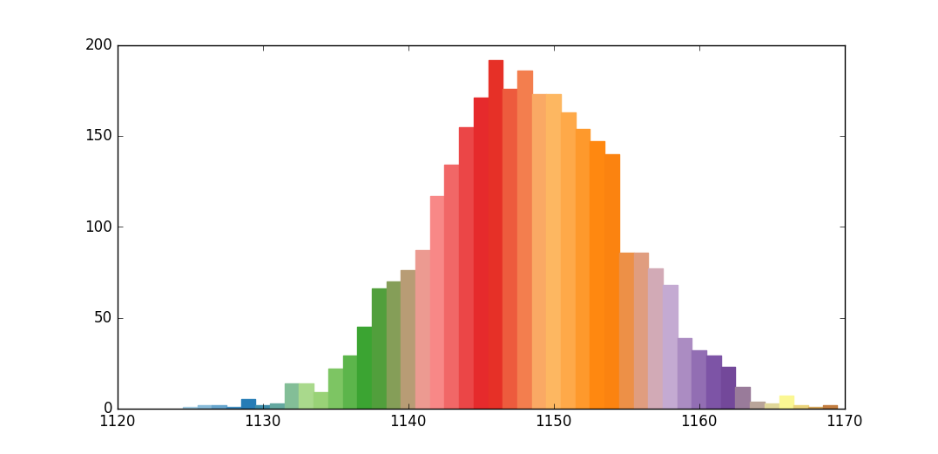
SCPCYC09

Slide 21
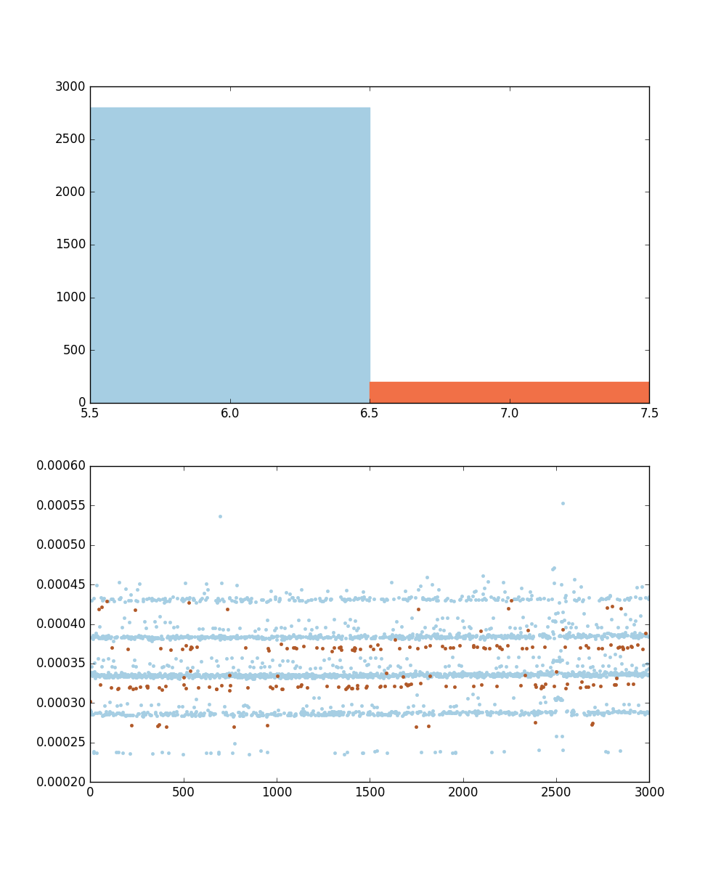
SCPE5

Slide 22
References
J.P.H. van Santen and A.L. Buchsbaum. Methods for optimal text selection. In
Proceedings of the European Conference on Speech Communication and Technology
(Rhodos, Greece), 2:553–556, 1997.
J.E. Beasley and P.C. Chu, “A genetic algorithm for the set covering problem”, European Journal of Operational Research, vol. 94, 1996, pp. 392-404
J.E. Beasley, “A Lagrangian heuristic for set covering problems”, Naval Research Logistics, Vol. 37, 1990, pp. 151-164
S. Haddadi, “Simple Lagrangian heuristic for the set covering problem”, European Journal of Operational Research, vol. 97, 1997, pp 200-204
U. Aickelin, “An indirect genetic algorithm for set covering problem” Journal of Operational Research Society, vol. 53, 2002, pp. 1118-1126

